Slide 1
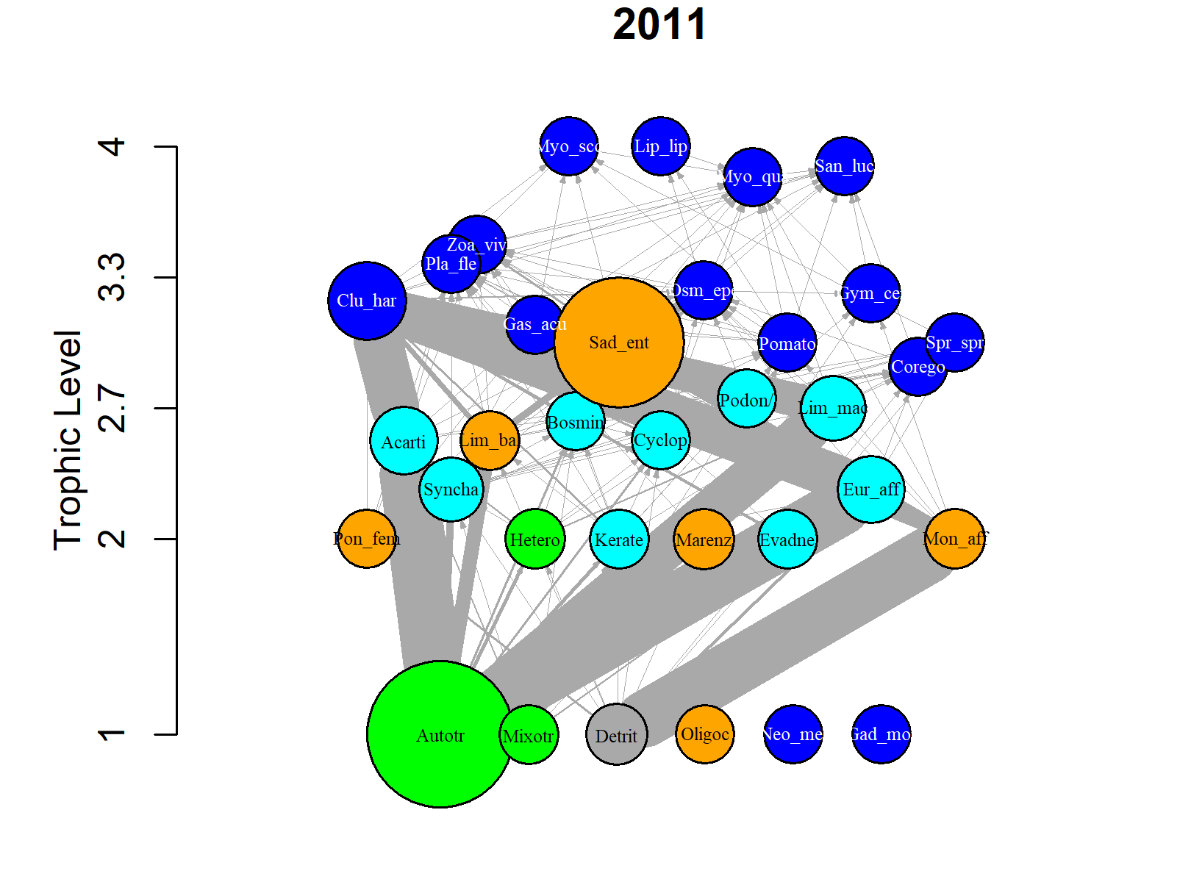
BEF relationships in an aquatic food web: what drives what?
SEM modeling – assessing relationships between biodiversity, food web structure and ecosystem functioning in a temporal context
Zoom Meeting 10.09.2020

Slide 2
Motivation
To establish the importance of various biodiversity aspects for ecosystem functioning in a multi-trophic and temporal context.
Good understanding of the relationships between species dynamics, species interactions (e.g. food web structure) and ecosystem functioning is relevant for ecosystem management and conservation.
Food webs provide key to identify important mechanisms of ecosystem functioning (or multifunctionality), because they contain information on the diversity, interaction structure and energy flow within the system.
Aim
Here, we try to disentangle the relationships among abiotic drivers (temperature and fisheries) and biotic ecosystem variables (such as species evenness, trait composition and food web structure) and their relative contributions to ecosystem functioning in a temporal context.

Slide 3
Background
Rooted in experimental studies, there is a common believe that species richness enhances ecosystem functioning (Tilman, Cardinale etc.).
However, this relationship does not necessarily apply to real-world field studies with «realistic» species abundances (Winfree et al. 2015), where dominance (biomass) or functional importance of common species have been identified as a main driver of ecosystem functioning (Maureaud et al. 2019).
Over the years BEF studies have derived at contrasting patterns and different conclusions about the BEF realtionships.
Theoretical studies have highlighted «the selection effect and complementarity» as mechanisms of ecosystem functioning (Loureau and Hector 2001).
Food web network studies emphasize the role of species diet overlap (also a measure of niche complementarity) for functioning (Duffy et al. 2007, Poisot et al. 2013), and empirical and experimental studies biomass and species richness (Barnes et al. 2016).
Due to discrepancies among studies, the relationship(s) beteween biodiversity, food web structure and ecosystem functioning remain(s) elusive and debated.
In this study, we can investigate all these ecosystem components under one framework. Hopefully, we can help clarify some of the controversy, or “just” make a humble contribution to a more nuanced picture of the BEF relationships.
Notes:
Defintions:
`selection effect', dominance by species with particular traits affects ecosystem processes
`complementarity effect', resource partitioning or positive interactions lead to increased total resource use

Slide 4
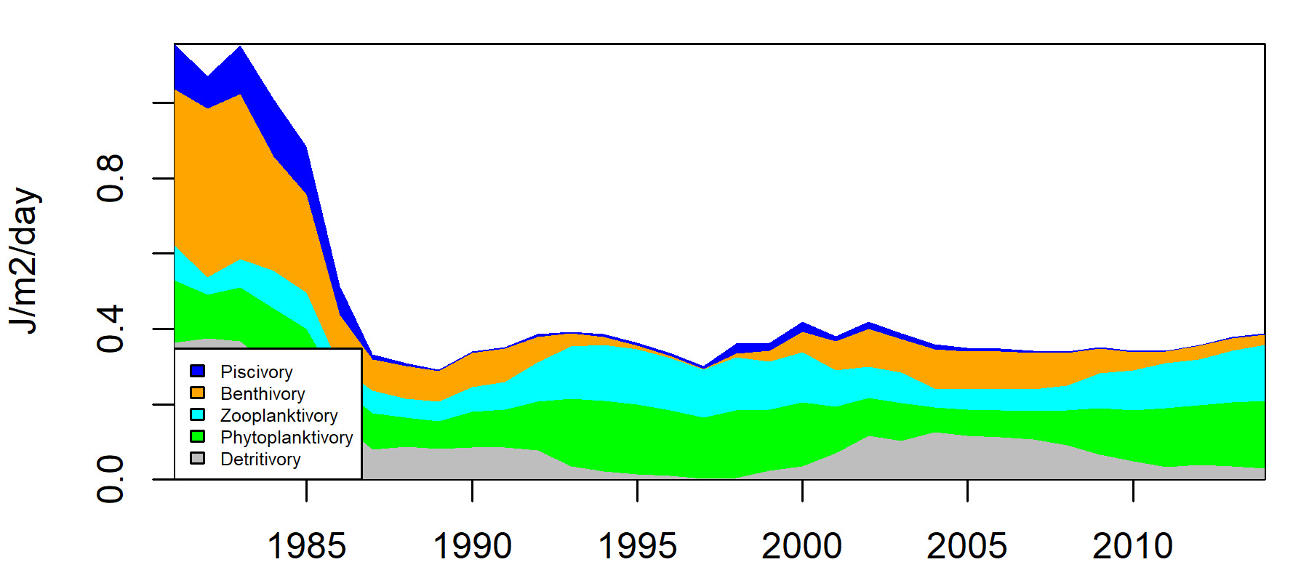
Define: What type of ecosystem functioning and how to define it?
Ecosystem functioning is traditionally defined by ecological processes, for example:
Productivity
Total biomass
Primary production
Secondary production
Pollination
Nutrient cycling
Total production (total energy flux)
We define ecosystem functioning as the total flux rate per m2 per day

Slide 5
Case study: Gulf of Riga
The Gulf of Riga is a a brakish-water semi-enclosed sub-basin of the Baltic Sea in Northern Europe. It is relatively shallow (~27m on average) and biological communties respond quickly to changes in the environment.
The study period spans from 1979 to 2016, but is now reduced to 1981-2014 due to a 5-y moving window to complete missing data in the time series

Slide 6
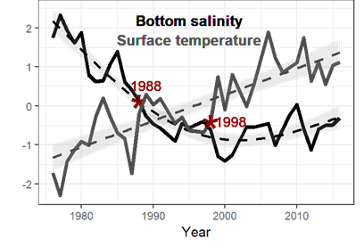
Environmental changes (1981-2014)
Sea surface temperatures have increased and bottom salinity decreased during the study period and have been identified as possible drivers of change
Environment
Standardised
Pecuchet et al. 2020 Ecography
Notes:
The Gulf of Riga is a relatively shallow (mean depth 26m) and isolated water-body of the Baltic Sea
It is connected to the Balti Proper via the Irbe strait
Residence time of water between 2-4 years
Environmental data extracted from the DAS database

Slide 7

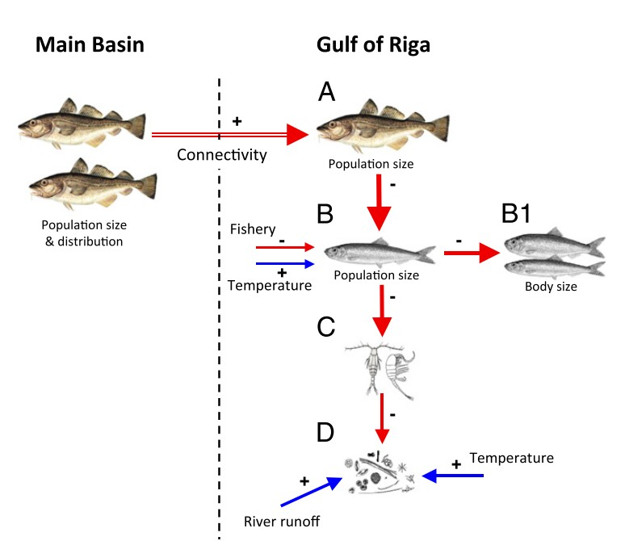
Changes in species dynamics (1981-2014)
Abrupt biological changes (regime shift) occurred at the end of the 1980s. This shift has been linked to the disappearence of cod (and increase in herring) with cascading effects on lower trophic levels.
Casini et al. 2012 PNAS

Slide 8
Changes in CW trait structure (1981-2014)
Large silica-wall → Motile
Deposit-feeder → Large scavenger
Feeding-current → Ambush feeder
Large piscivorous → Planktivorous
Pecuchet et al. 2019

Slide 9
Changes in food web structure and ecosystem functioning (1981-2014)
Kortsch et al. under review in JAE

Slide 10
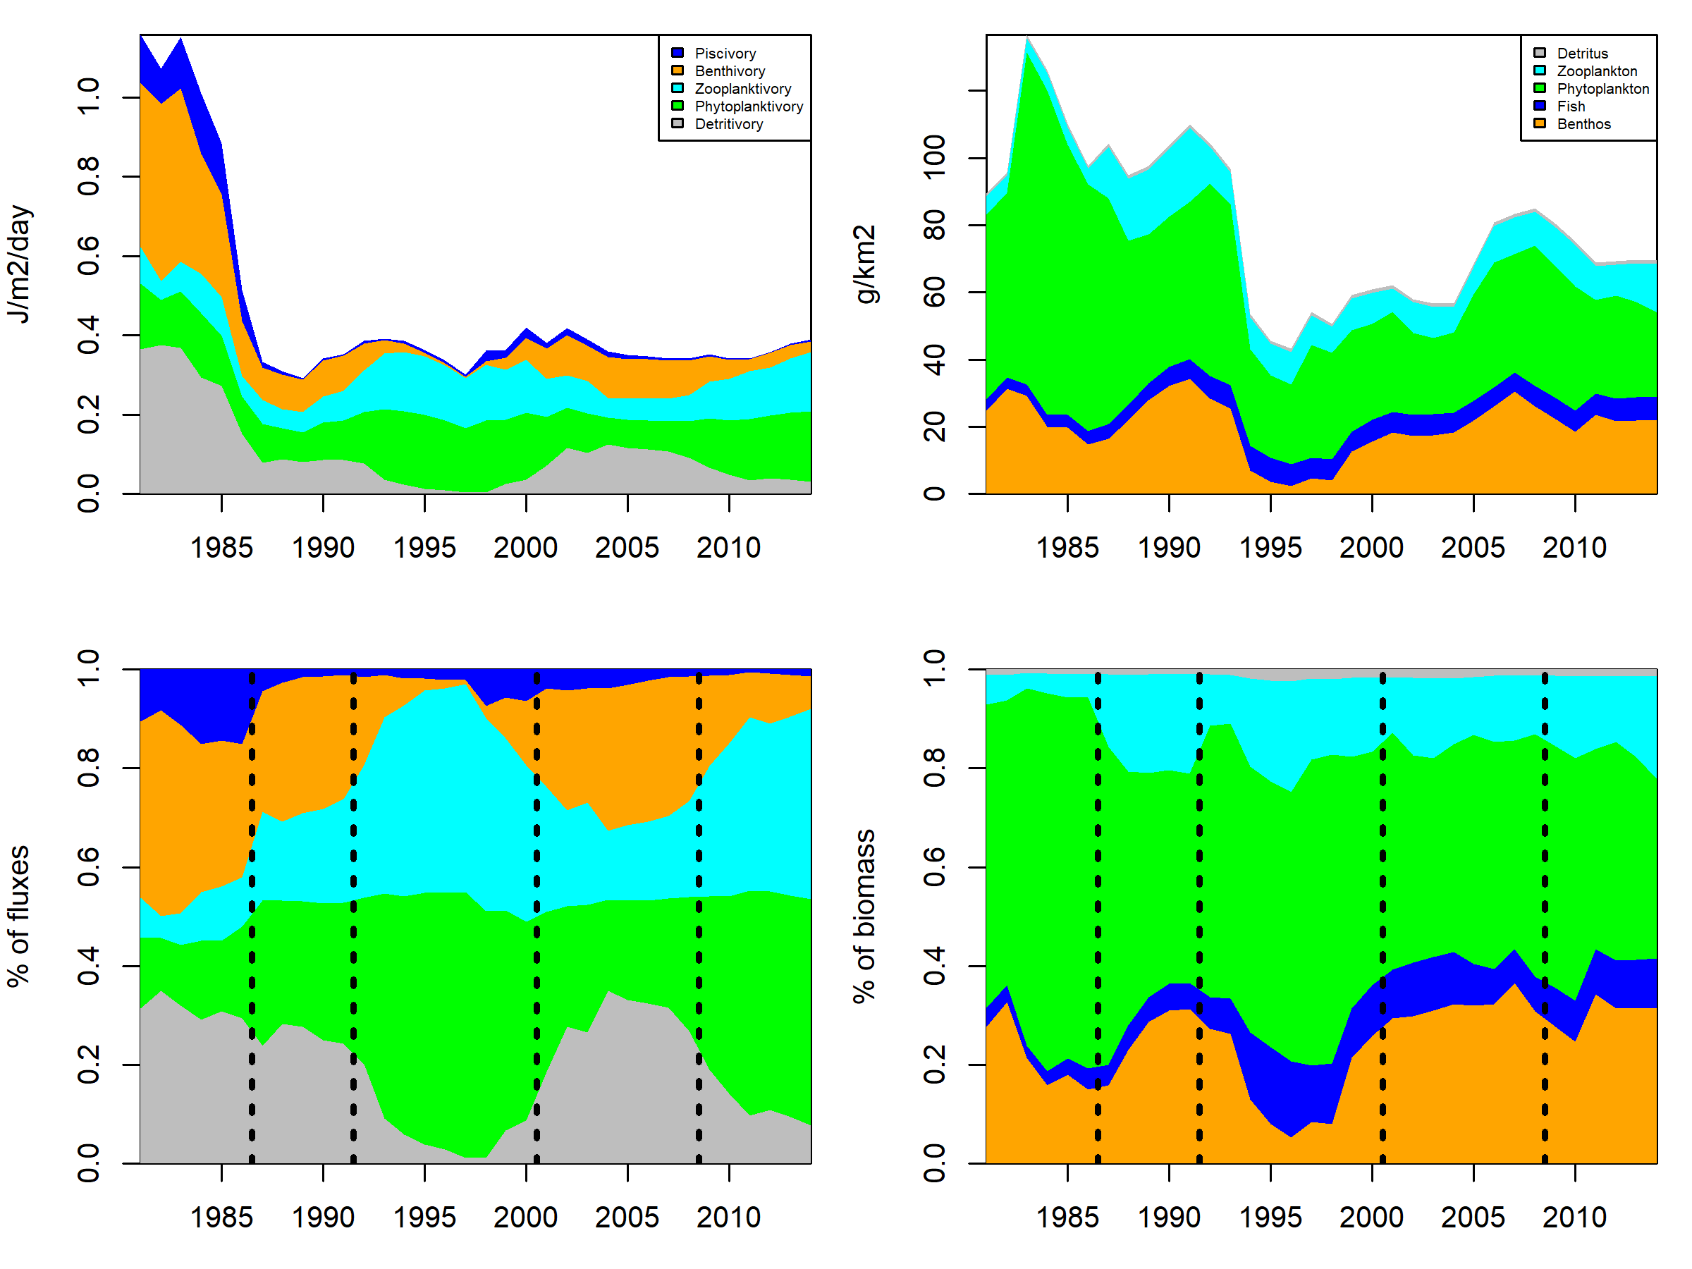
Biomass and Energy fluxes in the Gulf of Riga (1981-2014)
Can we convert J to g?
then we could calculate a P/B ratio = productivity
We might need to adjust assimilation efficiency of detritus
Production
Biomass
Fluxes are calculated using the Fluxweb R package by Gauzens et al. 2018, Methods Ecol. Evol.

Slide 11
Time series available
Species composition and biomass
Qualitative food webs and metrics
Quantitative food webs and metrics
Energy flux information
Environmental data: salinity, temperature, oxygen, phosphate, nitrate, NAO, AMO
Fisheries: Herring catches
Trait data: body masses, body length, motility, life span, feeding stratey

Slide 12
What drives ecosystem functioning?
Fisheries
Fishing effort of herring and sprat
Local Environment
Local: SST, O2
Global Environment
Large-scale: NAO, AMO
Species composition
b diversity
Jaccard dissimilarity on presence/absence
Species biomass
Total biomass of all species or only of specific groups e.g. total fish biomass
Ecosystem functioning
flux rate per m2
-energy flux dissimilarity
Should it be total or just that of specific components of the food web
Species interactions/Food web
Niche complementarity
Motifs shared resource and predator
Diversity of interactions
Nestedness
Species richness
of the food web?
Species eveness
Shannon
Simpsons
Species traits
- Functional dispersion proxy for niche complementarity
Feeding traits, motility, body mass, life span
Vertical vs. horisontal diversity
Evenness in energy flow
-weighted connectance
Sampling effect?

Slide 13
Method: SEM modeling
To assess and identify drivers of ecosystem functioning, we use a structural equation modelling (SEM) approach.
SEM is statistical framework suited to disentangle complex relationships between multiple ecosystem components in order to identify and assess the relative importance of mechanisms influencing ecosystem functioning. SEM requires the a priori formulation of research hypotheses about the proposed relationships.
Maureaud et al. 2019

Slide 14
Abiotic
Fisheries
Environmental
+++
Biotic
Species composition
alph/beta-div
Species evenness
Shannon
Species traits
Functional dispersion
Species biomass
g/m2
Food web
Nestedness
Niche complementarity
Ecosystem functioning
Biomass production
j/m2/day
positive
negative
both or neutral

Slide 15
Abiotic
Fisheries
Environmental
+++
Biotic
Species composition
alph/beta-div
Species
Evenness
Shannon
Food web
Nestedness
Species traits
Functional dispersion
Species biomass
g/m2
Food web
Nestedness
Niche complementarity
Ecosystem functioning
Biomass production
j/m2/day
positive
negative
both or neutral

Slide 16
Potential research questions
What drives changes in marine food web structure and functioning through time?
Are the changes determined by abiotic (e.g. temperature and salinity) or biotic (composition and species dynamics) variability, or fisheries? What are the relative influences of the different ecosystem/food web components on marine ecosystem functioning? Do these patterns change over time?
Can ecosystems with different species composition and trophic structure display similar overall functioning?
Is it necessary to have information on species interactions and food web structure to assess ecosystem functioning, or is it enough to “just” have knowledge on species biomass structure and trait composition, which are ecosystem components that are much easier to measure than food web complexity?
Other?

Slide 17
Issues/Questions/To-do-list
Improve the fluxweb model with predator prey preferences, and adjust assimilation efficiencies for detritus and phytoplankton groups as the numbers may be too low.
The fluxe rates are of independent from biomass and food web structure. Can this lead to circular reasoning?
Should the SEM model be based on dissimilarity matrices of the different variables?
Should we work on all years or a subset of years? Could the 5-y moving average of the species biomass structure and composition be a problem.
Limitations of temporal food web structure : species interactions in the food web are not realized interactions in time. They are inferred from the metaweb.

Slide 18
Data
Sampling stations offshore (below 20m)
Sampling intensity

Slide 19
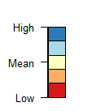
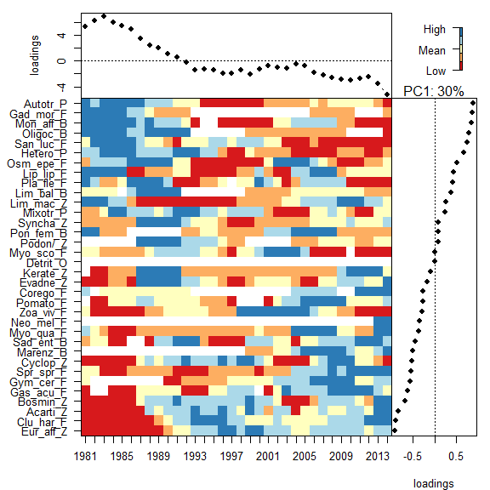
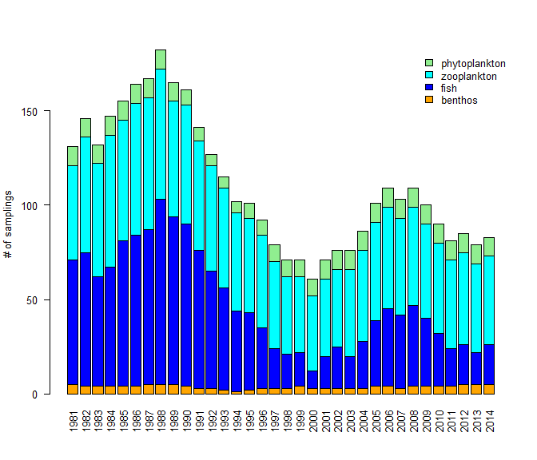
Species dynamics: composition and relative abundances
Species biomass through time
Visible shifts in the dynamics
around 1991 and after 2003
No complete sampling along the time series
=> 5 year moving average window
Notes:
- Between 1979 and 1990: Evadne nordmanni, Podon/Pleopis spp., Keratella spp.,
Bosmina spp.,
Monoporeia affinis, Oligochaeta spp.
Limecola balthica
cod (Gadus morhua).
- Between 2001 and 2014: heterotrophs,
Cyclops spp. and Cercopagis pengoi
Pomatoschistus minutus, Sprattus sprattus, and Gasterosteus aculeatus Marenzelleria

Slide 20
The food web metaweb

Slide 21
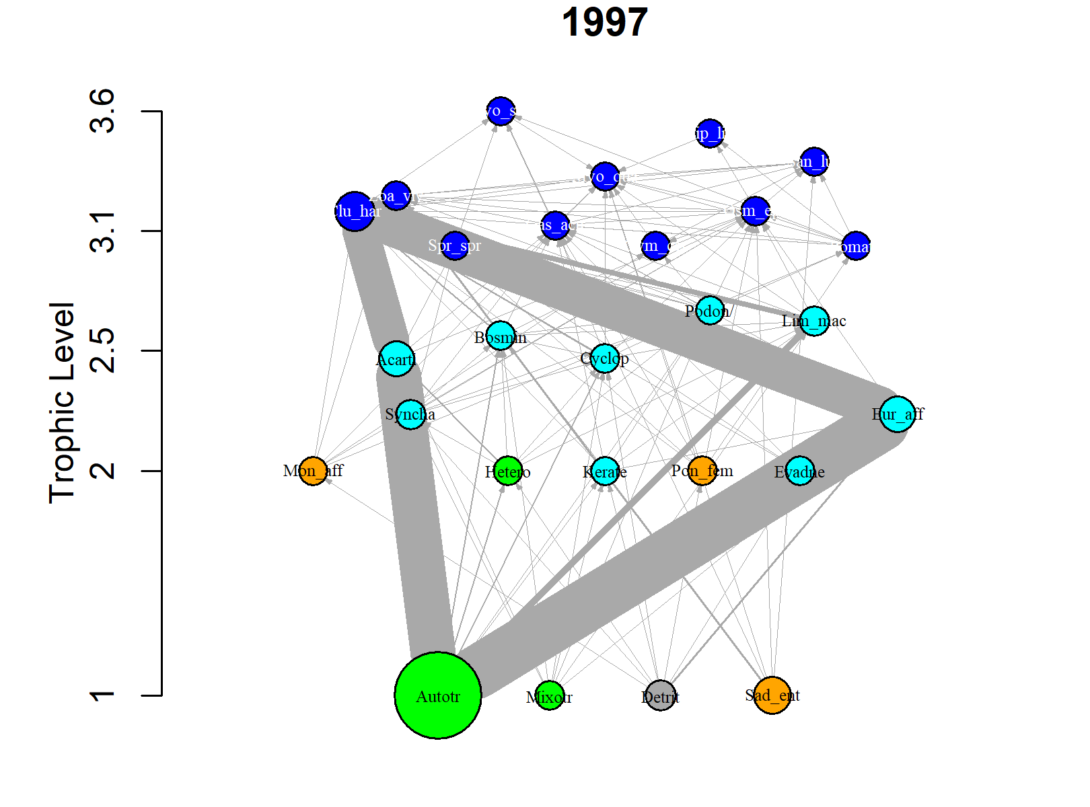
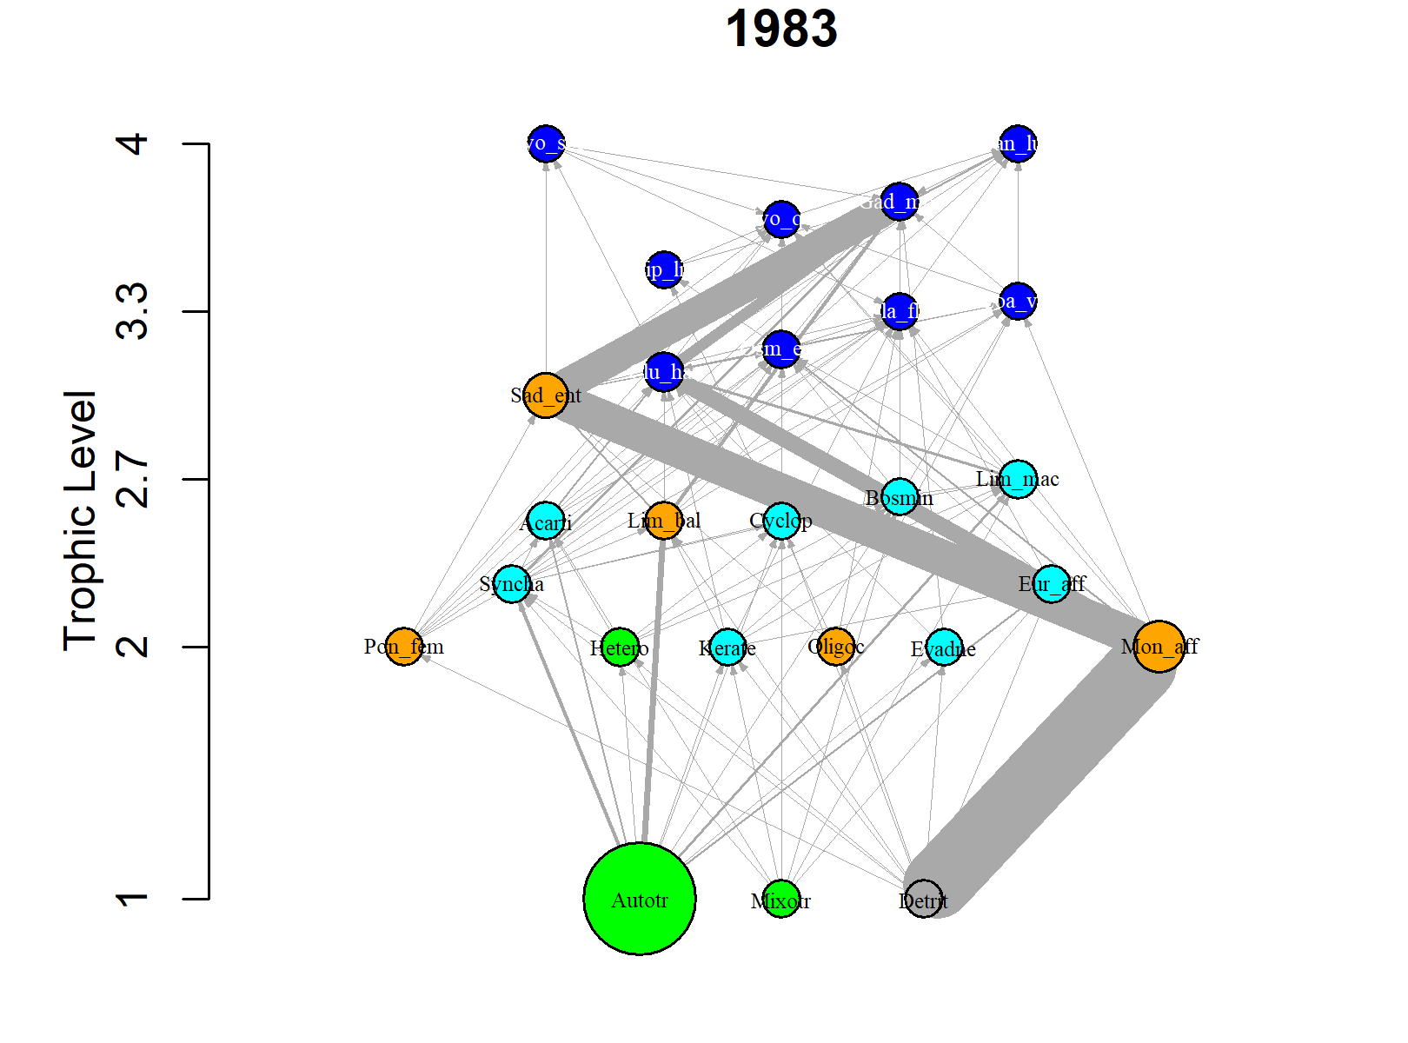
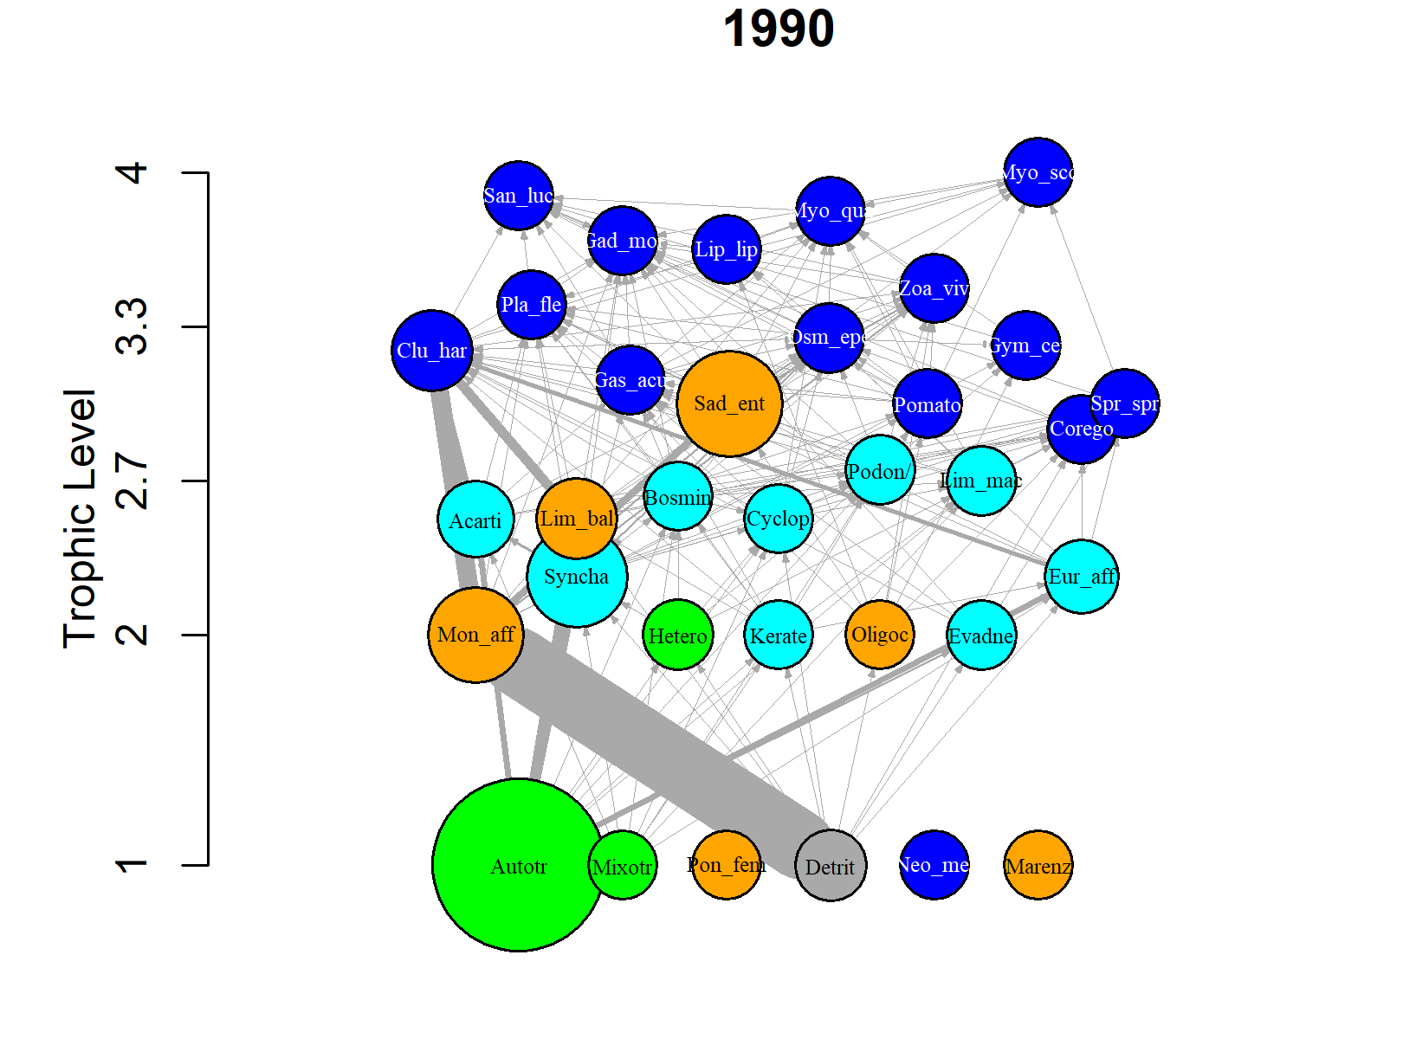
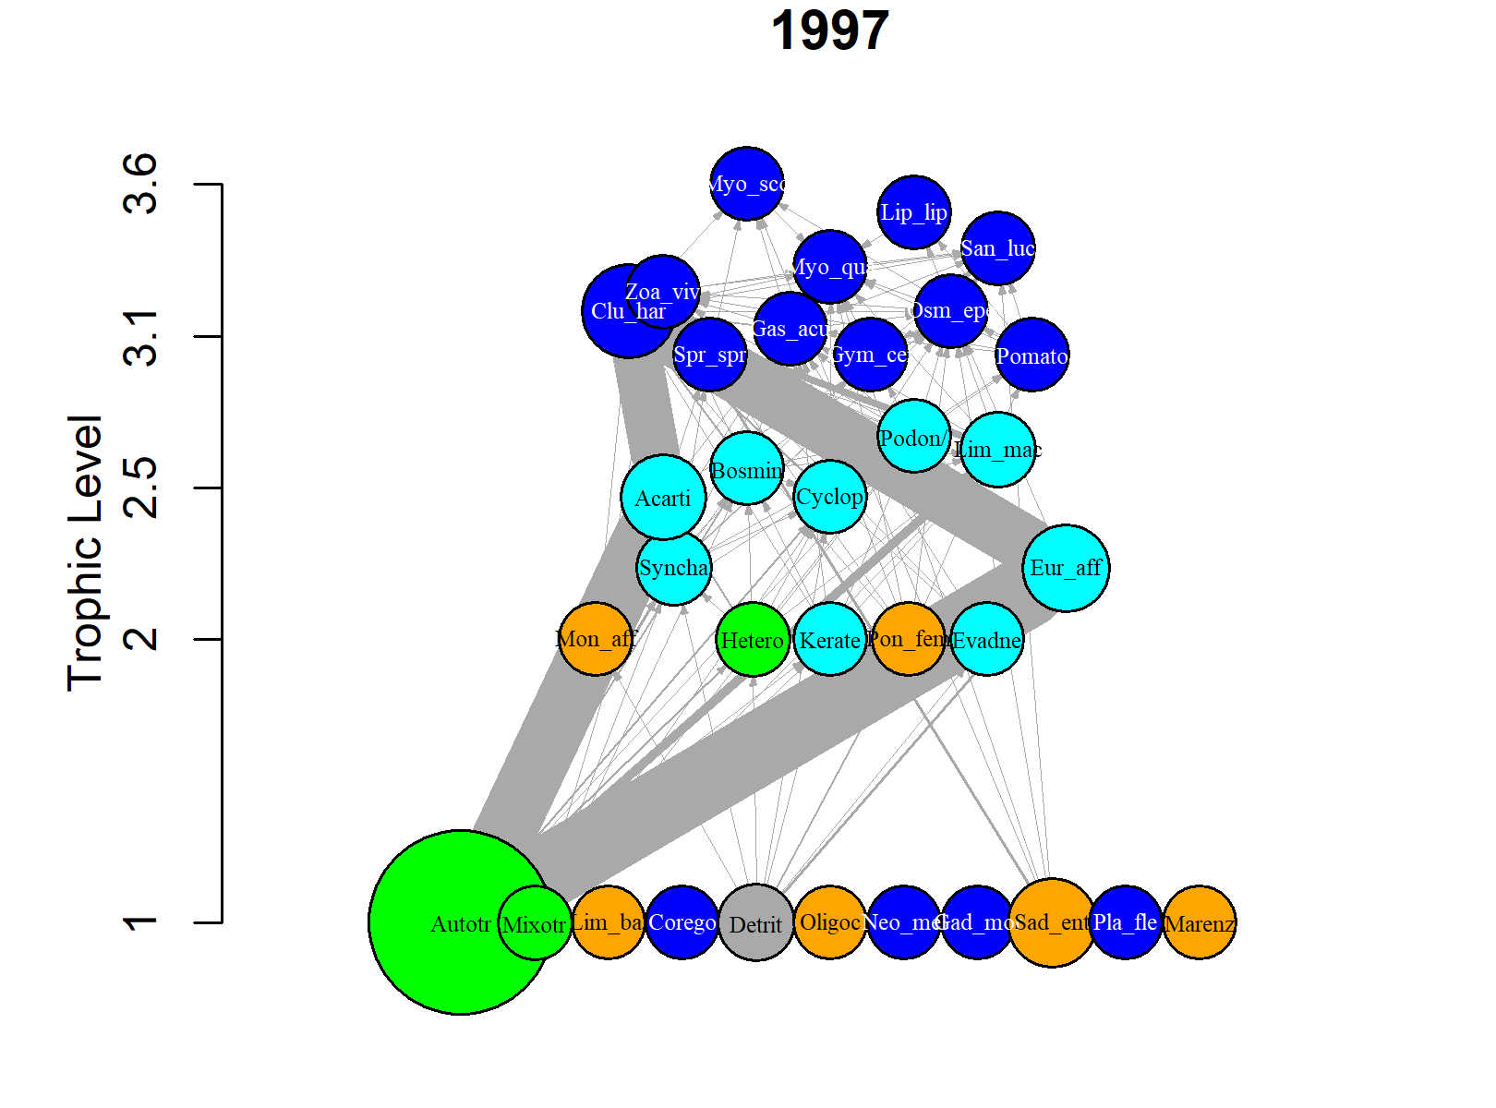
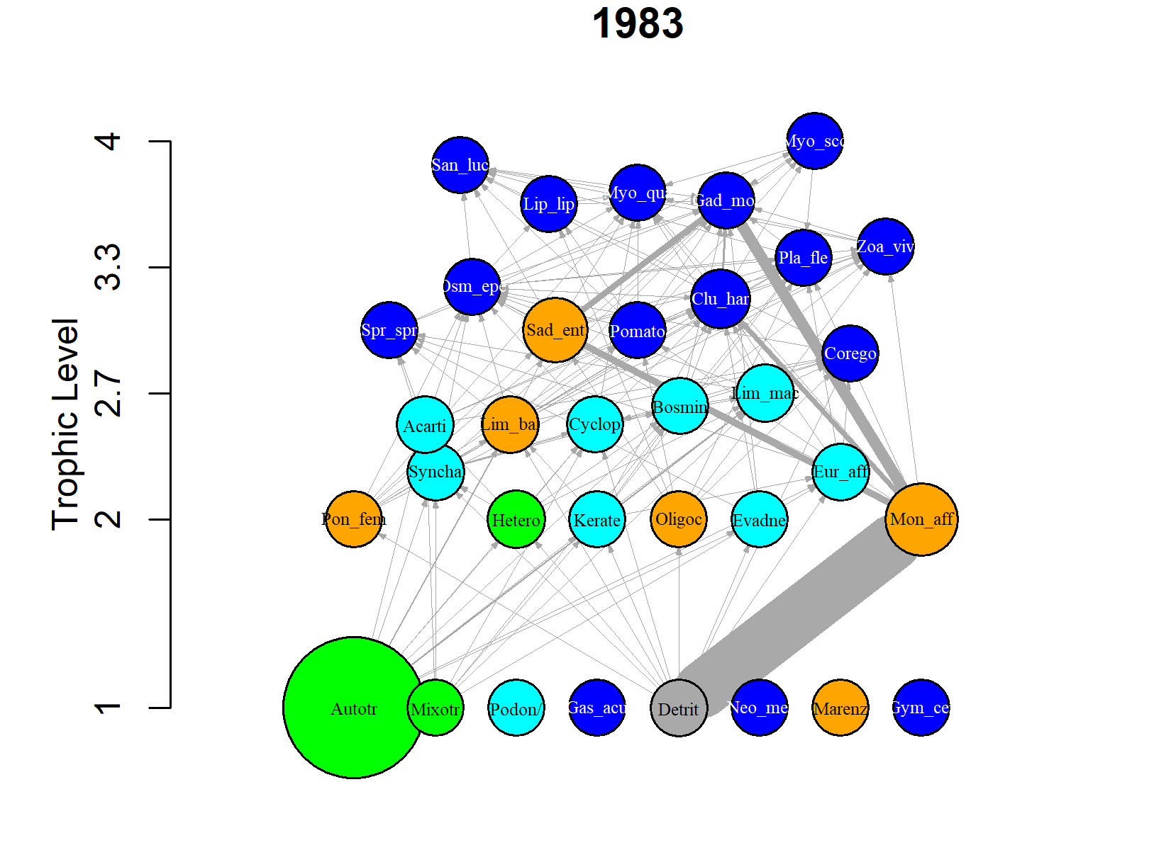
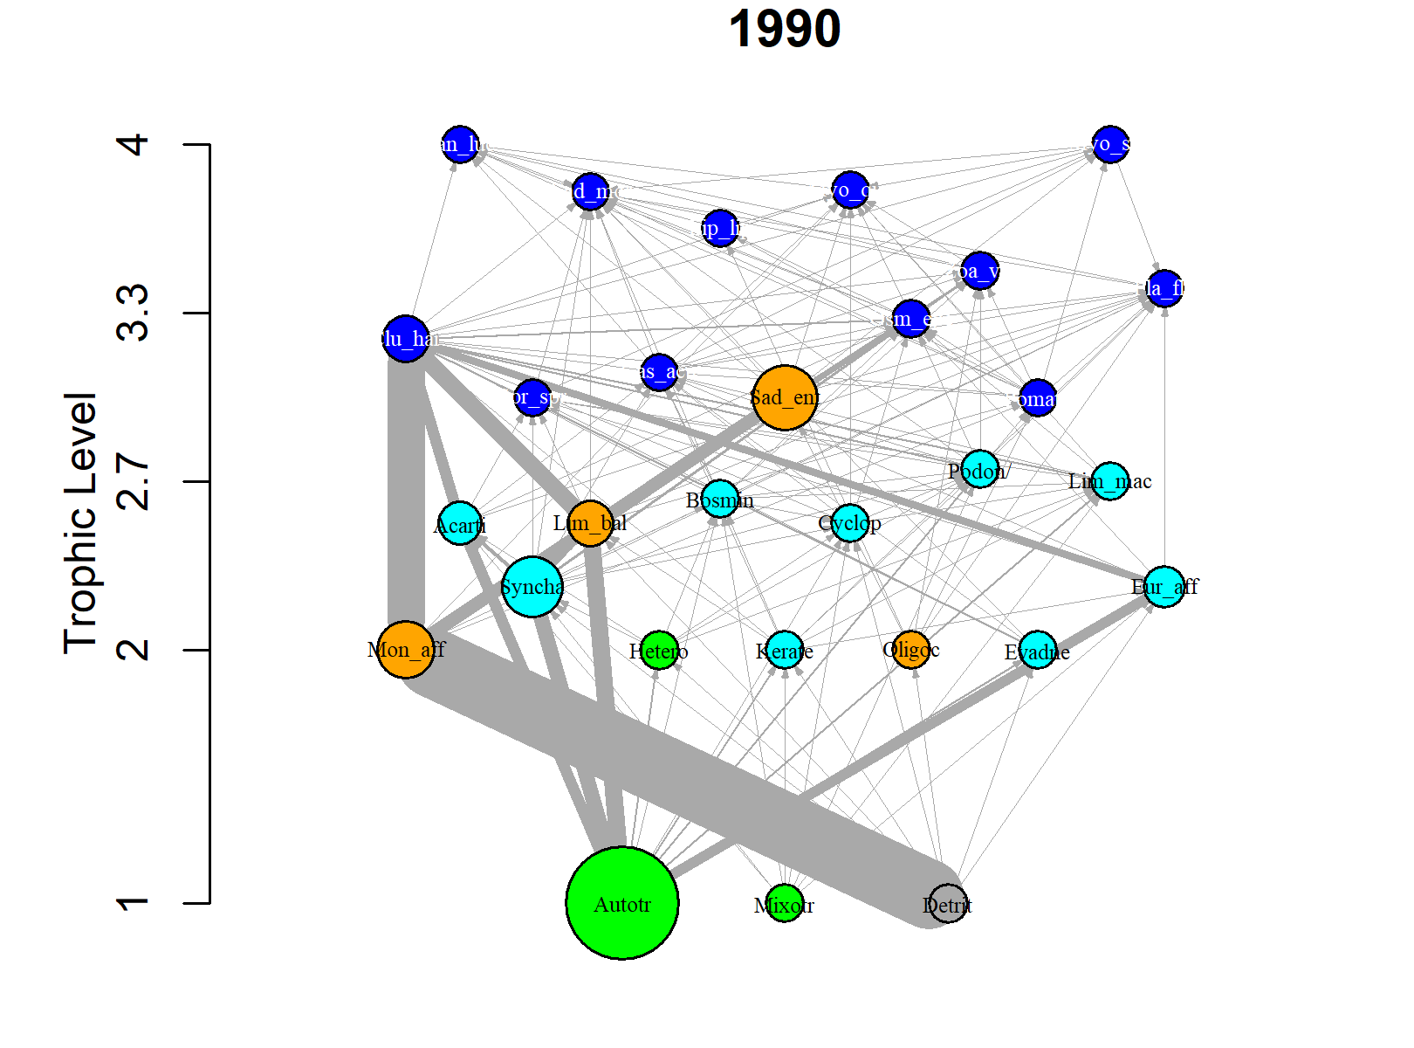
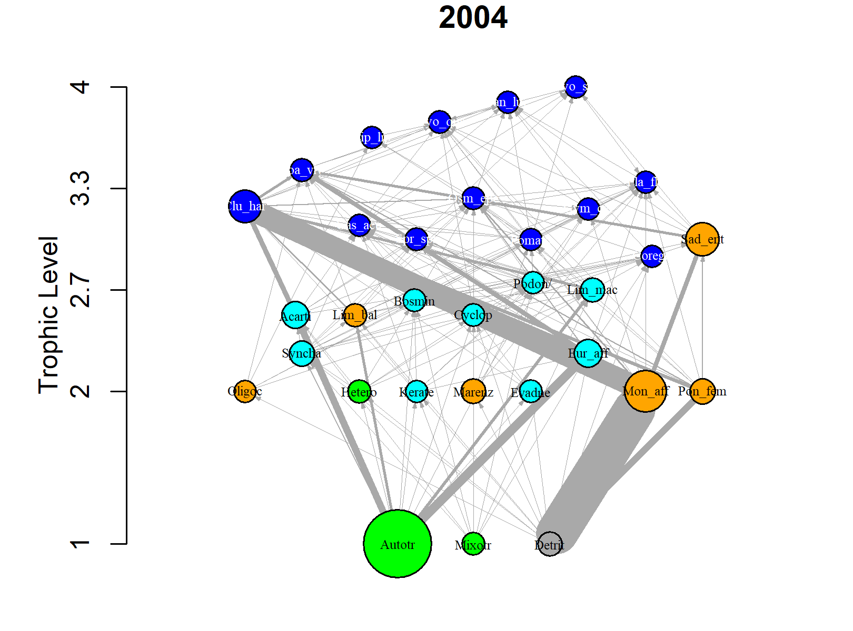
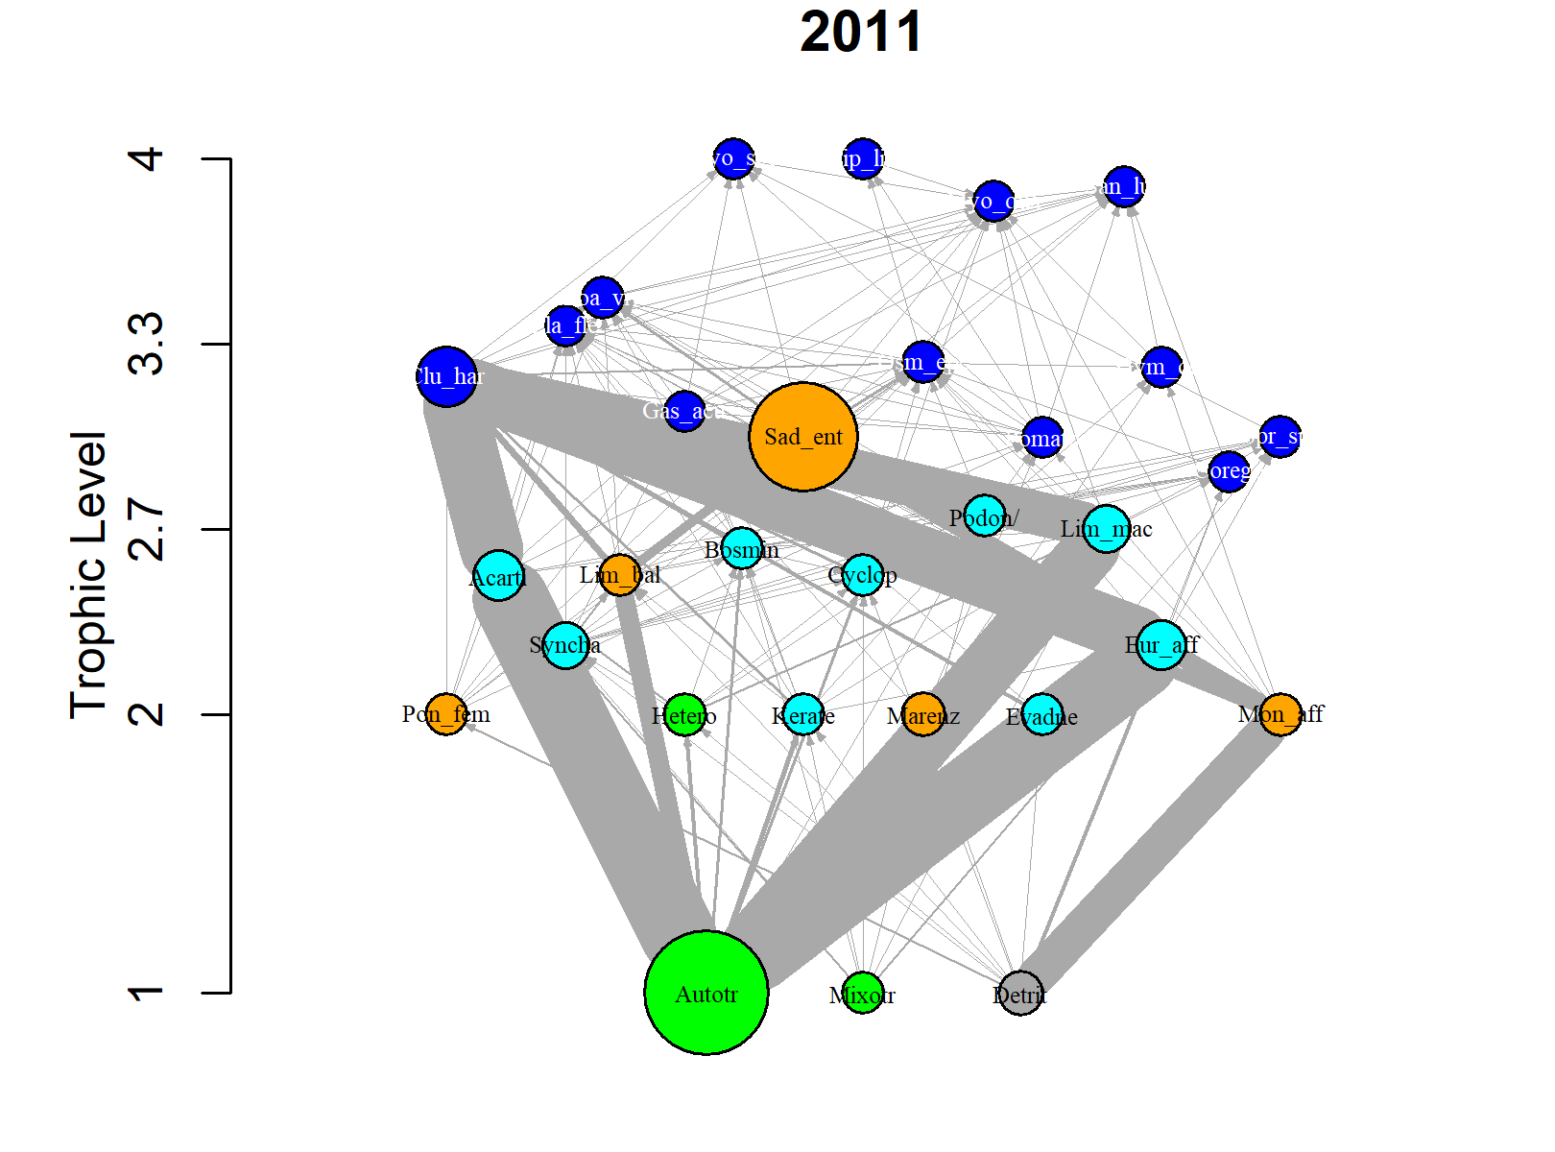
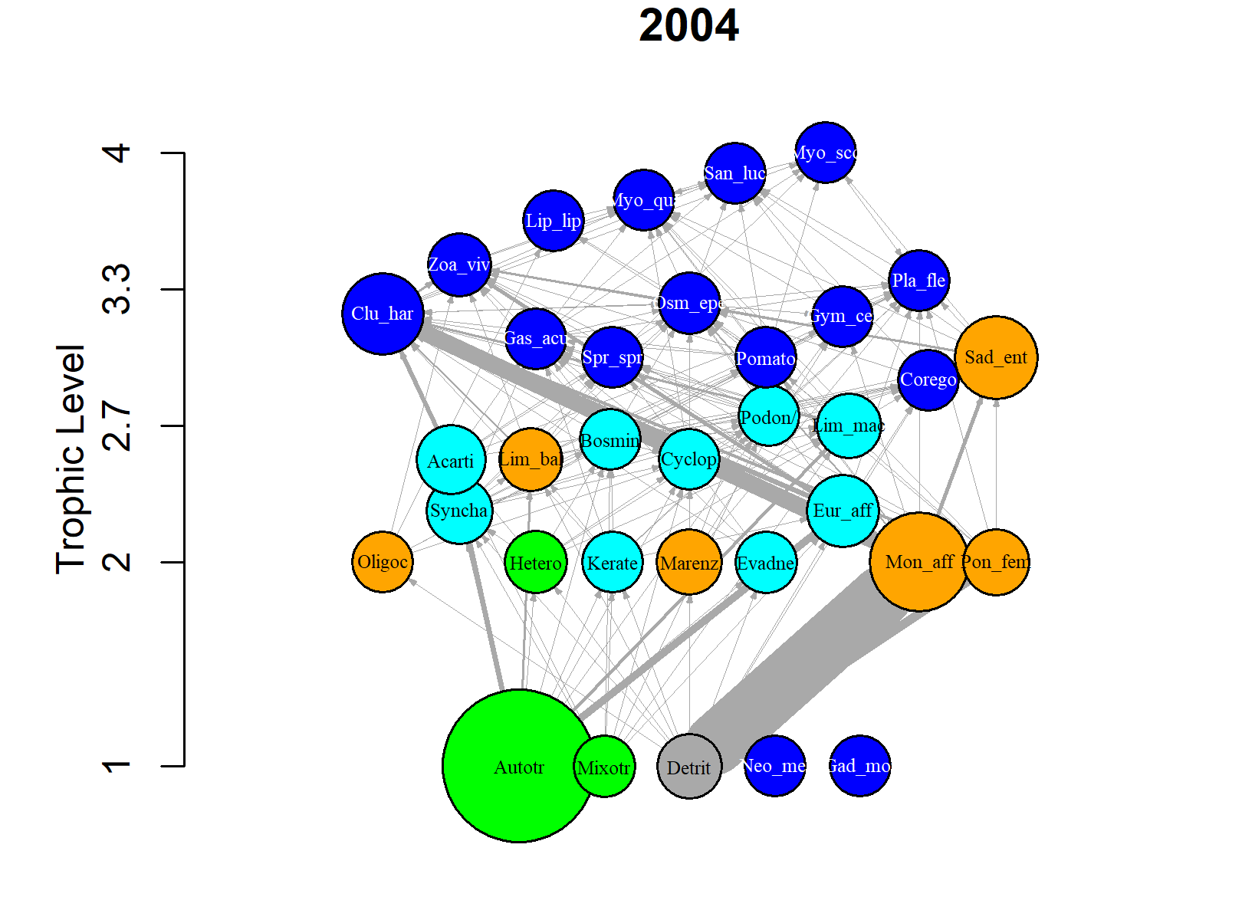
Food webs for selected years, node size=mean biomass (1000), edge size (energetic flows)
Selected years: 1983, 1990, 1997, 2004, 2011
Five food webs were selected with 7 years apart to minimize (re)sampling overlap of 1000 food webs due to the 5-year moving window. 1983 is influenced by samples from 1981, 1982, 1984, and 1985, but 1985 is also influenced by samples from 1986, and 1987, so to minimise overlap the next year chosen was 1990 which is influenced by samples from 1988, 1989, 1991, 1992, and so on. Each food web falls within a food web period determined by the previous multivariate analyses on yearly snapshot.

Slide 22
Food web metric time series

Slide 23
Biomass and Energy fluxes in the Gulf of Riga (1981-2014)
Can we convert J to g?
then we could calculate a P/B ratio = productivity
We might need to adjust assimilation efficiency of detritus
Production
Biomass
Fluxes are calculated using the Fluxweb R package by Gauzens et al. 2018, Methods Ecol. Evol.

Slide 24
Some possible hypotheses related to the SEM model
Environment
Local e.g. SST, Salinity, O2, Nutrients influence species composition and food web structure (Kortsch et al. 2015, Gibert 2018)
- Could be context-dependent
SST
C
Salinity
R
R
Δ fluxes
Δ variable
Fisheries
may reduce dominance of key species such as herring with consequences for food web structure and function, effects may cascade through the food web → as fisheries may have negative effects on total biomass of fish in the system, we may assume negative effect on total fluxes
C
Δ fluxes
R
R
Δ variable

Slide 25
Species richness
positive effects on ecosystem functioning.
However, if species overlap a lot in their resource use which can be investigated using the food web or the traits, then there might be no effect or even a negative effect. (Lefcheck and Duffy 2015)
C
C
Δ fluxes
R
R
R
R
R
Δ variable

Slide 26
Species composition or beta diversity
The composition of species in a community might affect ecosystem functioning through the specific attributes/traits that species confer. Depending on the identiy and attributes of species gained or lost in a community, the affect on functioning may be either be positive, nagative or neutral.
Species composition has many indirect effects on functoning mediated through changes in the trait composition, species evenness/domiance and food web structure etc.
C
R
Δ fluxes
R
R
Δ variable

Slide 27
Evenness (or dominance)
Low food web evenness and large and numerically abundant species may promote biomass production via the selection effect (Maureaud et al. 2019).
«Abundance of common species, not species richness, drives delivery of a real-world ecosystem service» (Winfree et al. 2015).
C
R
Δ fluxes
R
R
Δ variable

Slide 28
C
Food web biomass
Biomass scales positively with ecosystem funtioning because species biomass increases energetic demands (Barnes et al. 2016, Maureaud et al. 2019).
Some people also use biomass as a proxy of prodution and as a measure of functioning.
Since biomass is an important driver in the fluxweb. I wonder whether including it as a seperate component is a good idea.
Δ fluxes
R
R
Δ variable

Slide 29
Traits – measure of trait dominance
Functional dispersion, a measure of trait variability and a proxy for niche complementarity. Functional dispersion calculates the mean distance of species to community trait-mean centroid weighted by the relative abundance (FD package) (Barnes et al. 2016).
It is independent of species richness.
Functional dispersion can account for species abundances by shifting the position of the centroid toward the more abundant species and weighting distances of individual species by their relative abundances (LaLiberte and Lengendre 2010)
C
R
R
Δ fluxes
Δ variable
High complementarity in traits → high resource use –> high fluxes
However, in productive systems low complementarity and trait dominance could have a positive effect on fluxes

Slide 30
Nestedness measure of species niche overlap (food web structure)
Niche overlap is a proxy for competition and niche complementarity which describes overlap in resource use by different species (i.e. shared prey)→ high overlap in resource use = low complementarity = also high nestedness, and vice versa. Nestedness measures that can be used are e.g. NODF or NOS
C
C
C
C
R
Δ fluxes
R
R
R
Δ variable
High nestedness → high overlap in resource use
→low complementarity → low fluxes
According to the theory of niche complementarity, co‐occurring species or functional groups with different and specific ecological strategies (i.e., different fundamental niches), will lead to increased resource exploitation and thus to a positive relationship between biodiversity and ecosystem functioning.

Slide 31
Literature cited
Barnes et al. 2016. Species richness and biomass explain spatial turnover in ecosystem functioning across tropical and temperate ecosystems. Phil. Trans. R. Soc. B 371: 20150279.
Cardinale et al. 2012. Biodiversity loss and its impacts on humanity. Nature 486: 59-67.
Duffy et al. 2007. The functional role of biodiversity in ecosystems: incorporating trophic complexity. Ecol. Lett. 10: 522–538
Gibert 2018 Temperature directly and indirectly influences food web structure. Scientific reports 9:5312.
Lefcheck and Duffy 2015 Multitrophic functional diversity predicts ecosystem functioning in experimental assemblages of estuarine consumers. Ecology 96: 2973–2983.
Loreau and Hector 2001. Partitioning selection and complementarity in biodiversity experiments. Nature
Maureaud et al. 2019 Biodiversity–ecosystem functioning relationships in fish communities: biomass is related to evenness and the environment, not to species richness. Proc. R. Soc. B 286: 20191189.
Poisot et al. 2013 Trophic complementarity drives the biodiversity–ecosystem functioning relationship in food webs. Ecol. Lett. 16: 853–861.
Tilman et al. 2014. Biodiversity and Ecosysten functioning. Annu. Rev. Ecol. Ecol. Syst, 45: 471-492.
Winfree et al. 2015. Abundance of common species, not species richness, drives delivery of a real-world ecosystem service. Ecol. Lett. 18: 626–635

